Slide 1
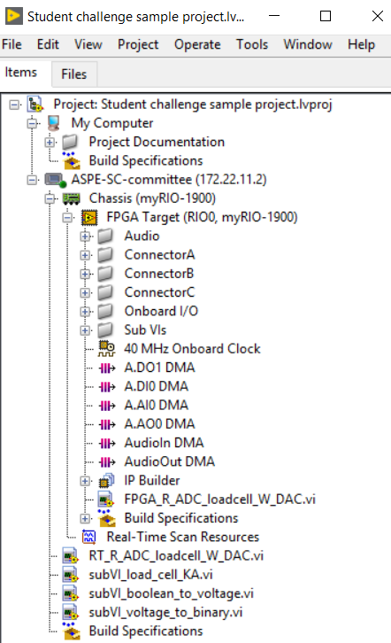
LabVIEW project provided by the committee
Before running the programs, make sure your myRIO is connected by right clicking here and choosing Connect
myRIO chassis
One could open the LabVIEW project provided by the committee and use it with your hardware.
VI that runs on FPGA target
VI’s that runs on Real Time processor

Slide 2
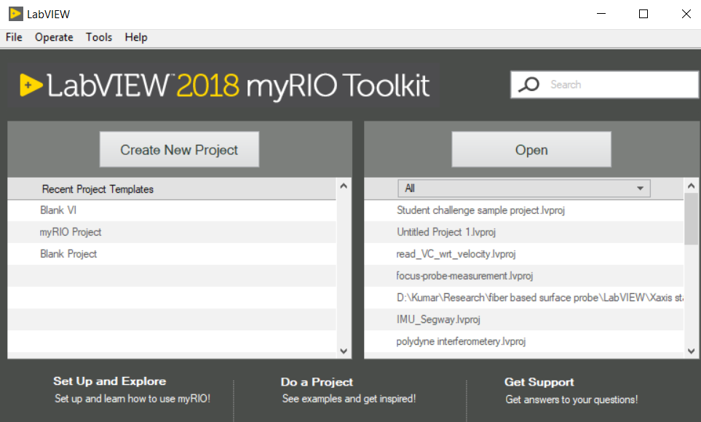
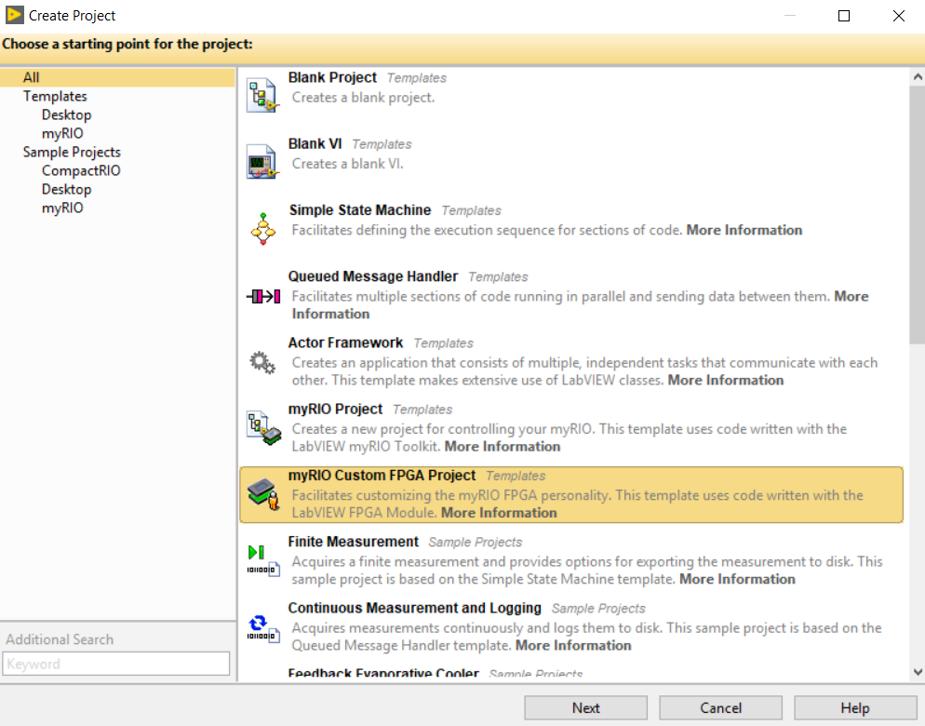
Steps to generate your own project (if you want to)
Choose Create New Project
Choose myRIO custom FPGA project

Slide 3
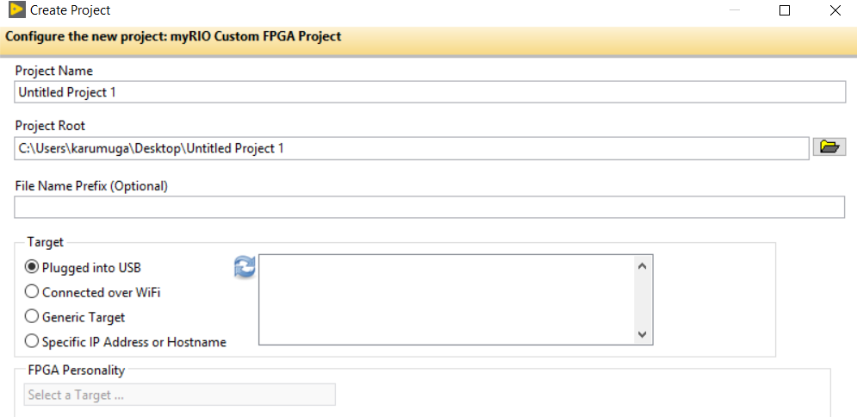
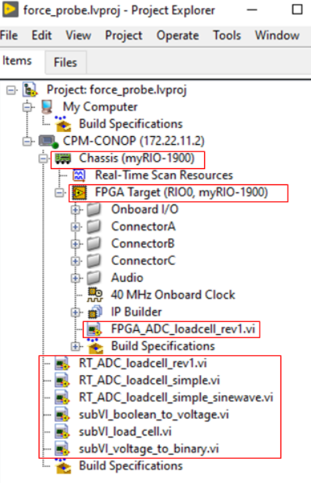
Steps to generate your own project
Make sure to connect a myRIO using a USB, give a project
name, and click finish
MyRIO chassis
VI that runs on FPGA target
VI’s that runs on Real Time processor
Drag and drop the Real-Time programs (RT_XXX) to the Chassis and the FPGA program (FPGA_XXX) to the FPGA Target.

Slide 4
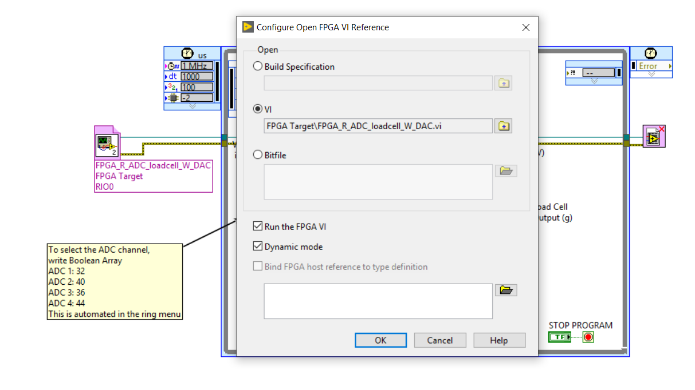
Steps to generate your own project (if you want to)
You might need to double click here and select the FPGA VI in the Open FPGA Reference block in the RT program,

